Slide 1
Robotic Process Automation
Name: Patil Nikhil Ishwar
Roll No: 45 Class: TYBBA(CA)
Subject: SoftSkills

Slide 2
Index
What is Robotics?
What is RPA?
Evolution of RPA
Why RPA is used?
Benefits of RPA
Application of RPA
Example of RPA Application
Steps Involved in RPA
Difference between RPA & Regular Automation
Top RPA Vendors
Advantages and Disadvantages
Future of RPA

Slide 3

What is Robotics?
Robotics is the combination of engineering, science and technology that produces a machine called robot.
Robotics is a domain where people work with the development and use of robots.
It is mostly used as an alternative of human beings in various works.

Slide 4

What Is Robotic Process Automation (RPA)?
Robotic process automation (RPA) is the use of software with artificial intelligence (AI) and machine learning capabilities to handle high-volume, repeatable tasks that previously required humans to perform. These tasks can include queries, calculations and maintenance of records and transactions.
RPA technology, sometimes called a software robot or bot, mimics a human worker, logging into applications, entering data, calculating and completing tasks and logging out.

Slide 5
Evolution of RPA
Although the term "robotic process automation" can be traced to the early 2000s, it had been developing for a number of years previously.
RPA evolved from three key technologies: screen scraping, workflow automation and artificial intelligence.
Screen scraping is the process of collecting screen display data from a legacy application so that the data can be displayed by a more modern user interface.

Slide 6
Why RPA is Used?
Companies and business owners these days use the RPA. It is due to the multiple programs they have to access simultaneously.
Automating the data correction is one of the benefits of RPA.
Sales orders and invoice processing are the two areas where the RPA process can shine. Additionally, RPA also increases data consistency levels across the company department systems.
With any change in the business process, a company would need to hire new employees or train existing employees to map the IT system and business process. Both solutions are time and money-consuming. Also, any succeeding business process change will need hiring or retraining.

Slide 7
Benefits of RPA
Robotic process automation technology can help organizations on their digital transformation journeys by:
Enabling better customer service.
Ensuring business operations and processes comply with regulations and standards.
Allowing processes to be completed much more rapidly.
Providing improved efficiency by digitizing and auditing process data.
Creating cost savings for manual and repetitive tasks.
Enabling employees to be more productive.

Slide 8
Benefits of RPA(Employee’s Perspective)
Accuracy: Extreme accuracy and uniformity – much less prone to error or typos
Improved Employee Morale: Workers can decide more time to engaging intersecting work
Low technical Barrier: No Programming skills necessary to configure a bot
Productivity: Process cycles times are much faster compared to manual process approaches.
Reliability: Bots tirelessly work 24x7 without interruption.
Consistency: Routine tasks are performed the same way each and every time.

Slide 9
Applications of RPA
Some of the top applications of RPA include:
Customer service: RPA can help companies offer better customer service by automating contact center tasks, including verifying e-signatures, uploading scanned documents and verifying information for automatic approvals or rejections.
Accounting: Organizations can use RPA for general accounting, operational accounting, transactional reporting and budgeting.
Financial services: Companies in the financial services industry can use RPA for foreign exchange payments, automating account openings and closings, managing audit requests and processing insurance claims.

Slide 10
Applications of RPA
Healthcare: Medical organizations can use RPA for handling patient records, claims, customer support, account management, billing, reporting and analytics.
Human resources: RPA can automate HR tasks, including onboarding and offboarding, updating employee information and timesheet submission processes.
Supply chain management: RPA can be used for procurement, automating order processing and payments, monitoring inventory levels and tracking shipments.

Slide 11
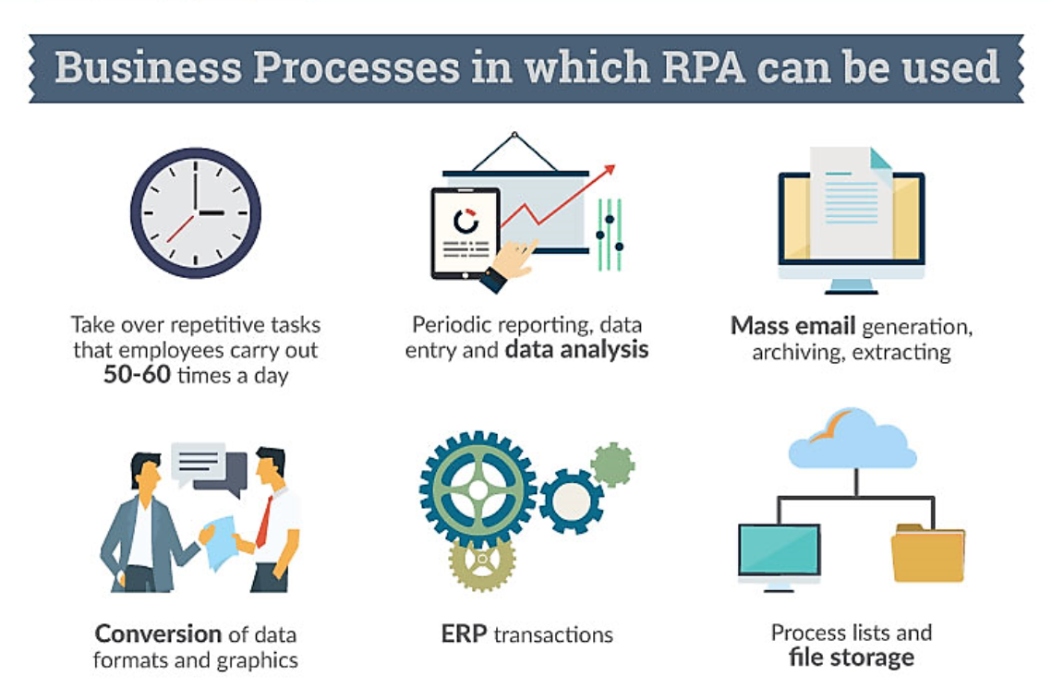

Slide 12
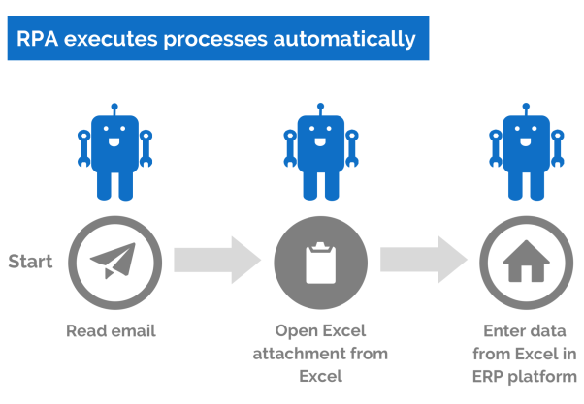
Example for RPA Example

Slide 13
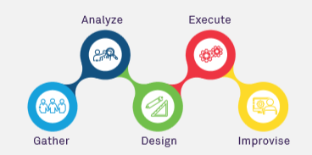
Steps Involved in RPA

Slide 14
Difference between RPA and Regular Automation
What distinguishes RPA from traditional IT Automation is the ability of the RPA software to be aware and adapt to changing circumstances, exceptions and new situations.
Once RPA software has been trained to capture and interpret the actions of specific processes in existing software applications, it can then manipulate data, trigger responses, initiate new actions and communicate with other systems autonomously.

Slide 15
Difference between RPA and Regular Automation
RPA software is particularly useful for organizations that have many different and complicated systems that need to interact together fluidly.
For instance, if an electronic form from a human resource system is missing a zip code, traditional automation software would flag the form as having an exception and an employee would handle the exception by looking up the correct zip code and entering it on the form. Once the form is complete, the employee might send it on to payroll so the information can be entered into the organization's payroll system.
With RPA technology, however, software that has the ability to adapt, self-learn and self-correct would handle the exception and interact with the payroll system without human assistance.

Slide 16
Top RPA Vendors
Automation Anywhere Inc. provides an enterprise digital workforce platform geared toward procure-to- pay, quote-to-cash, HR, claims processing and other back-office processes.
Blue Prism focuses on providing organizations in regulated industries with more agile virtual workforces, offering desktop-aligned robots that are defined and managed centrally.
EdgeVerve Limited, an Infosys company, helps enterprises modernize customer service, improve business processes and enhance operational productivity.

Slide 17
Top RPA Vendors
HelpSystems enables companies to streamline IT and business operations by automating tasks and workflows without the need to write code.
UiPath offers an open platform to help organizations efficiently automate business processes.
Workfusion combines robotics, AI-powered cognitive automation and workforce orchestration to automate enterprise business processes

Slide 18


Advantages and Disadvantages of RPA
Pros
Cons
Cost Efficient
Hands-free convenience
Save Time with Automated Tasks
Manage Multiple Devices
Less errors compare to humans
Notifications in case of trouble
Reduces Workload
Installation Cost
Complexity
Setup and Configuration
More Technical Security Threats
Increases unemployment
Privacy Concerns
Maintenance & Repair Issues

Slide 19
Future of RPA
Robotic process automation is just getting started. As the technology matures and becomes more widespread, we'll see increasing innovation in automation-both from the creators of RPA solutions and from the businesses that use them.
One of RPA's greatest strengths is its ability to interface and merge with other technology.
The next years will see a growth in RPA working with other powerful solutions, including cognitive computing and business process management applications.
The use of software robots has the potential to change work as we know it.

Slide 20
Thankyou

